Slide 1
Project 3
Kenneth cheong

Slide 2
Problem statement
To differentiate between two different subreddits from reddit.com

Slide 3
Data collection
Collected data using the reddit API
Subreddits chosen were
989 posts
962 posts

Slide 4
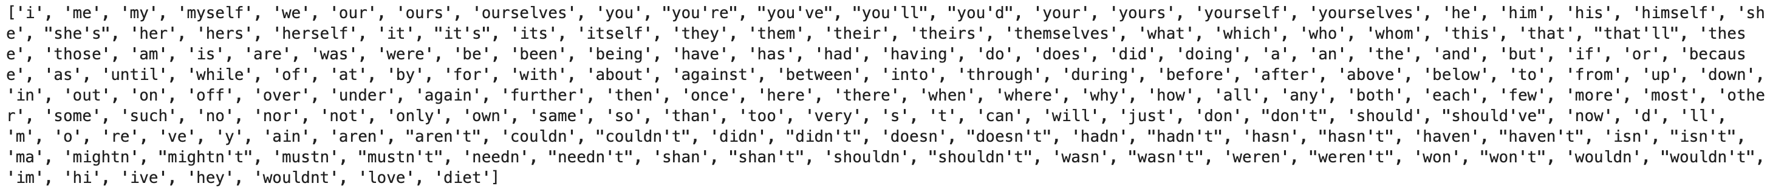
Data cleaning & processing
Originally 1951 rows, removed 133 null rows, probably due to non-worded comments
Rows were labelled according to the subreddit they were from
Removed components such as line splitters ‘\n’, punctuation and converted to lower case
Lemmatization
Stop words removed

Slide 5
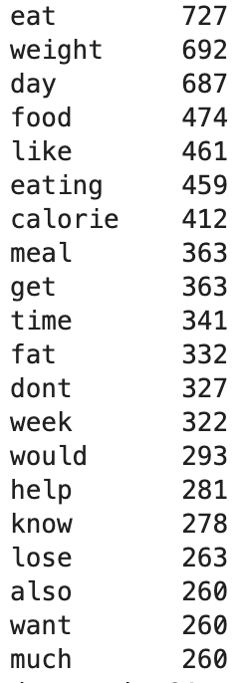
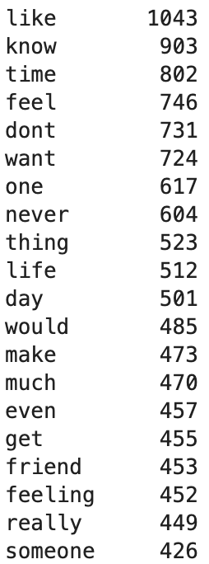
Top 20 most common words

Slide 6
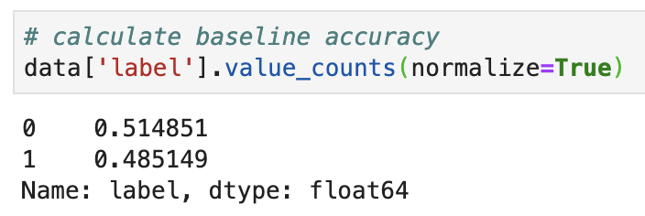
Modelling
Checking baseline
Train-Test-Split

Slide 7
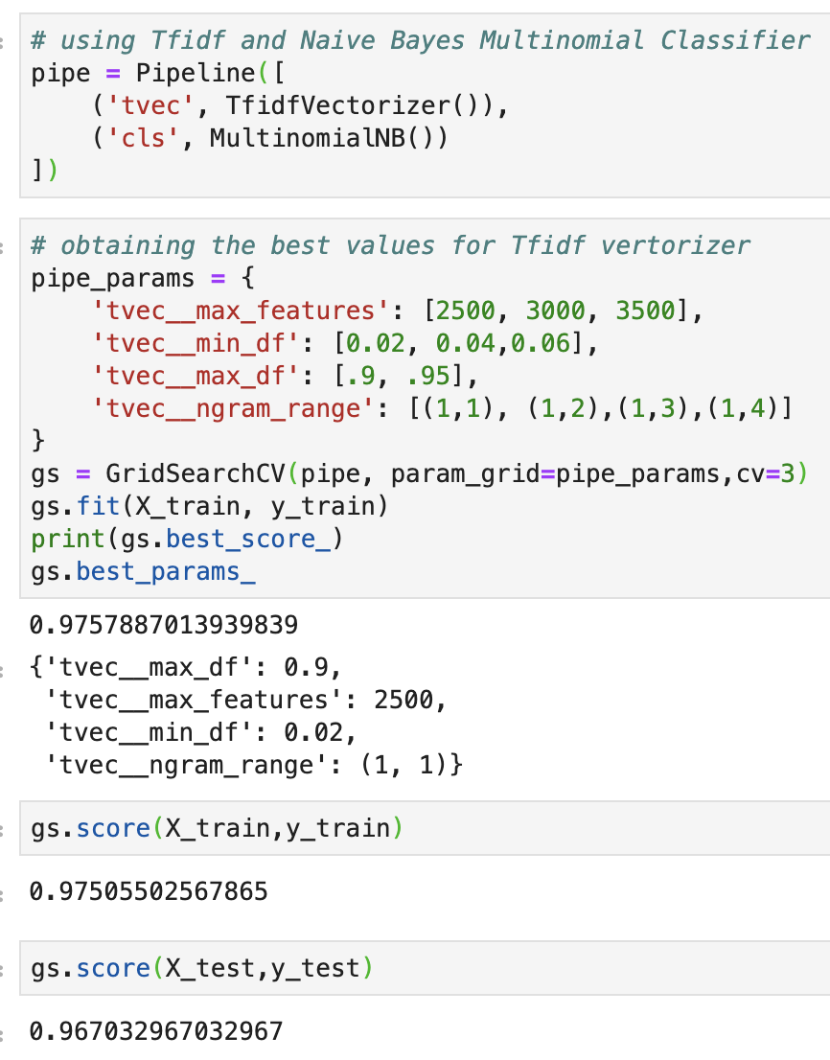
Modelling
Using Tfidf and
Naïve Bayes Multinomial Classifier

Slide 8
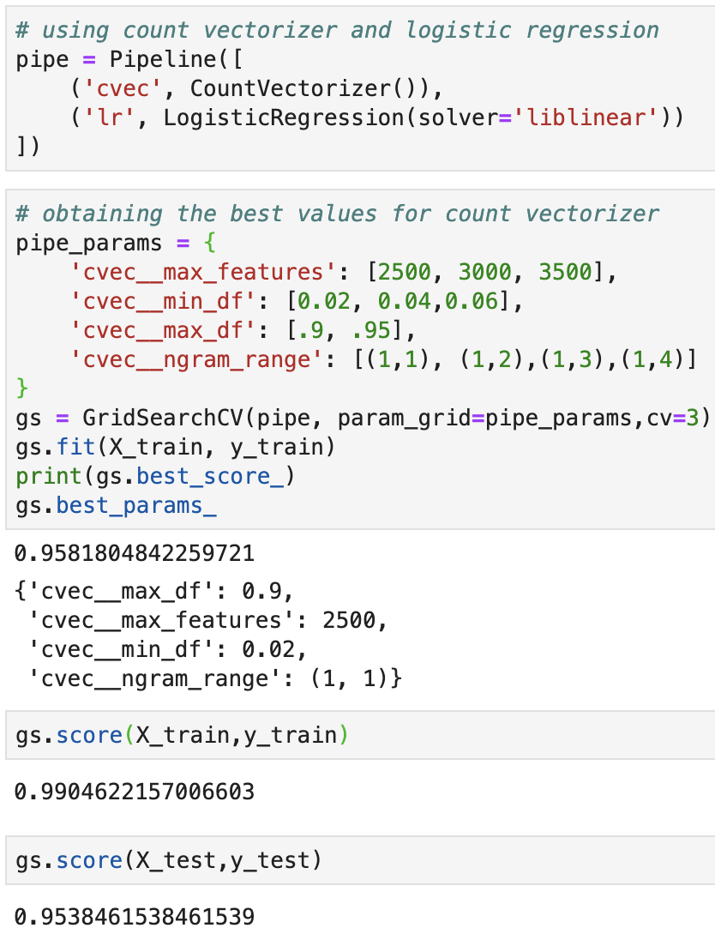
Modelling
Using Count Vectorizer and Logistic Regression

Slide 9
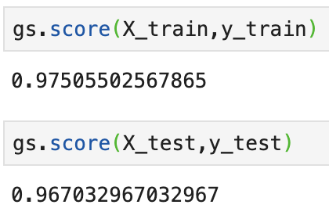
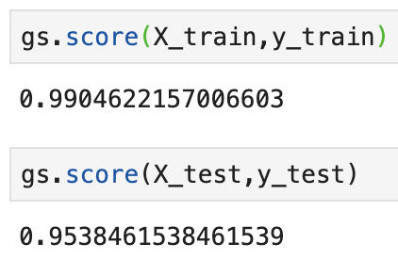
Conclusion
Use Tfidf and Naïve Bayes Multinomial Classifier as variance is lower
Tfidf and Naïve Bayes Multinomial Classifier
Using Count Vectorizer and Logistic Regression

